Slide 1
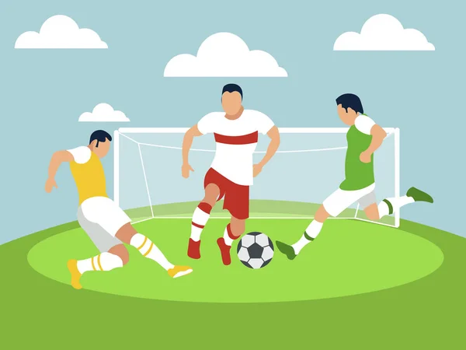


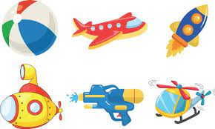
Write about your friends.
Bob Lennon, 10
This is my friend Bob.
Bob’s surname is Lennon.
He is 10.
His favourite sport is football.
His favourite colour is red.
He has got a ball and a plane.

Slide 2



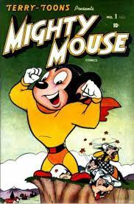
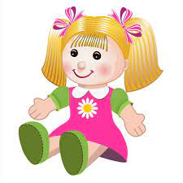
Write about your friends.
Ann Lennon, 8
This is my friend Ann.
Ann’s surname is Lennon.
She is 8.
Her favourite sport is dancing.
Her favourite colour is blue.
She has got a comic and a doll.

Slide 3
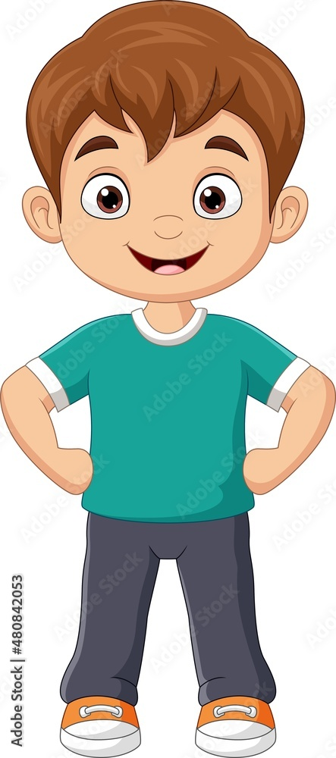
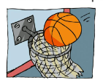





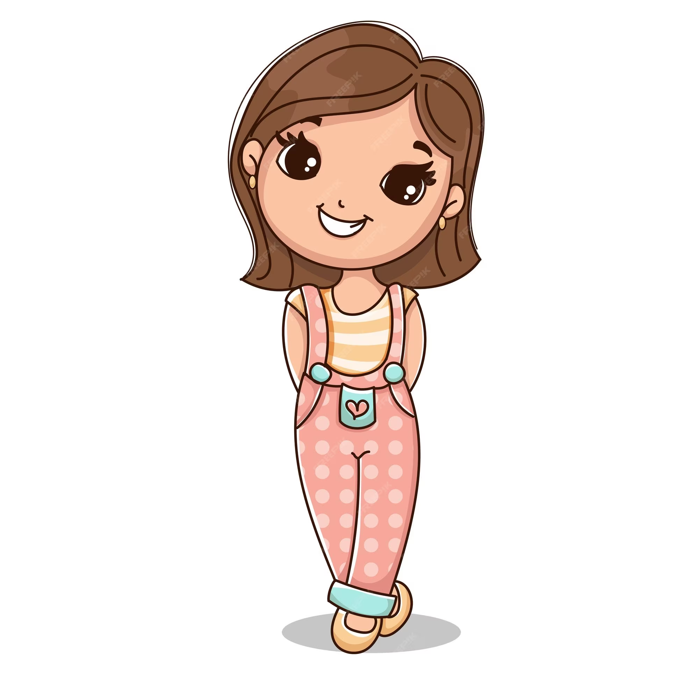


Mick Brown, 10
Lara Crox, 11

